Slide 1
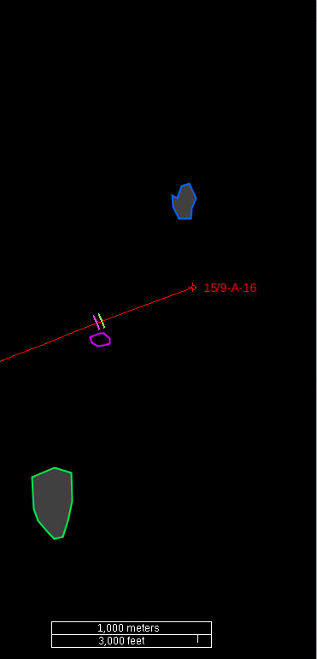
Seismic observed feeders represented by polygons
Main feeder (the chimney) polygon Well constrained area with high confidence, because the chimney can actually be directly interpreted on the seismic repeated data The main chimney is observed on several layers and at all acquisition times, and the diameter increases with depth The rationale for choosing this particular polygon:
Layer 8 is the shallowest layer where the main chimney is observed, consequently it is least affected by overburden
The chimney diameter is smaller/better constrained in the shallower than in the deeper layers
Alternatively 1999 vintage could be chosen, however, layer 8 was not developed well enough in 1999 to constrain the outline of the chimney properly
North-eastern feeder (Layer 5 to Layer 6) Relatively poorly constrained area with lower confidence because the feeder can not be directly seen on the seismic data The rationale for choosing this particular polygon:
The area constrained by the 1999 observation of enhanced amplitudes in layer 6 and the extent of (the underlying) Layer 5
South-western feeder (Layer 7 to Layer 8) Relatively poorly constrained area with lower confidence because the feeder can not be directly seen on the seismic data The rationale for choosing this particular polygon:
The area constrained by the 2008 observation of enhanced amplitudes in layer 8 and the extent of (the underlying) layer 7
2)
1)
3)

Slide 2
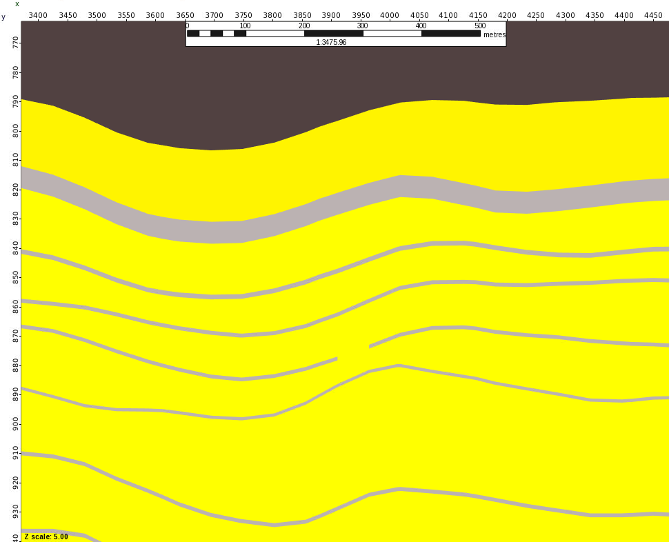
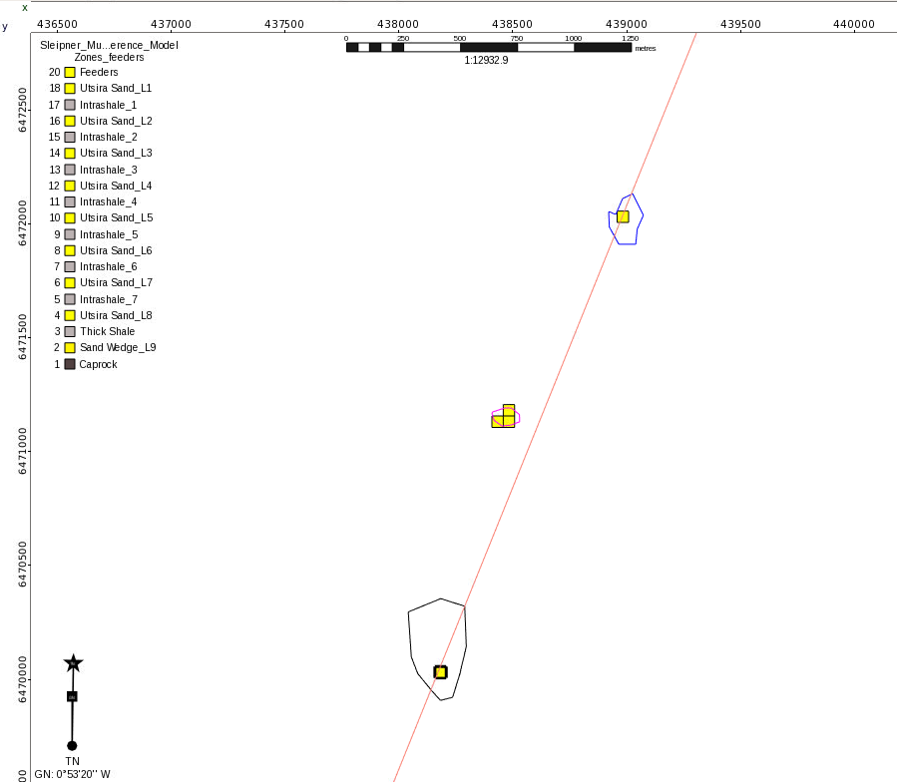
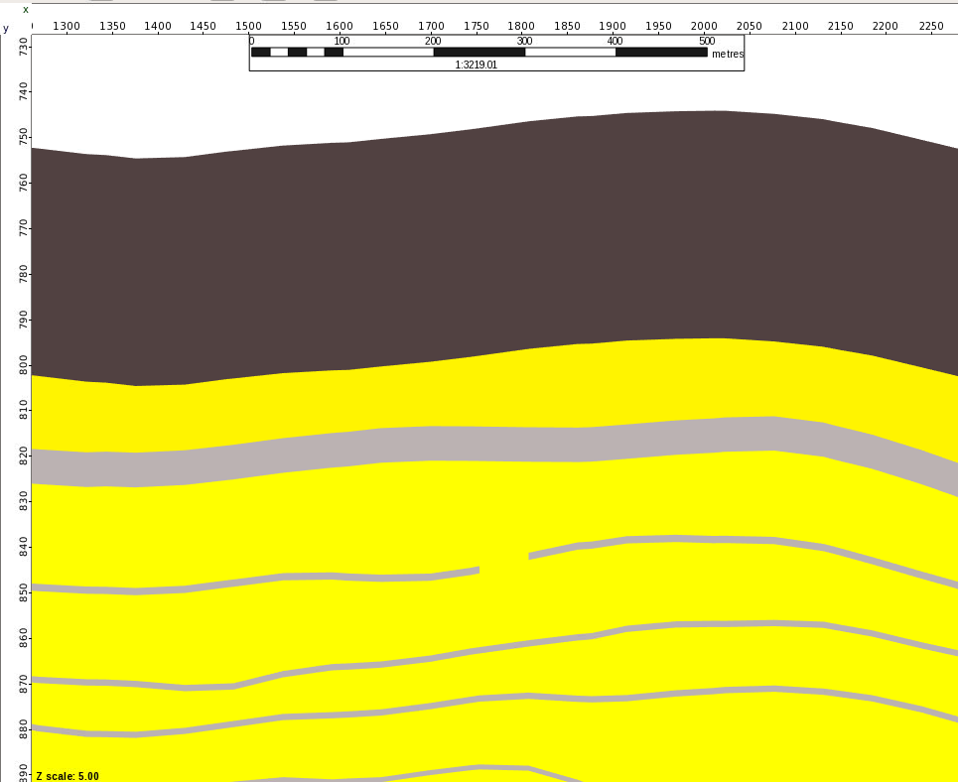
Feeders (NE – L5 to L6 and SW – L7 to L8)
Ramdomly selected point within each polygon area for illustration purposes (feeder within the low confidence area interpreted on seismic) – one grid cell wide is 50m x 50m wide
Caprock
SW
L6
L5
Caprock
SW
L8
L7

Slide 3
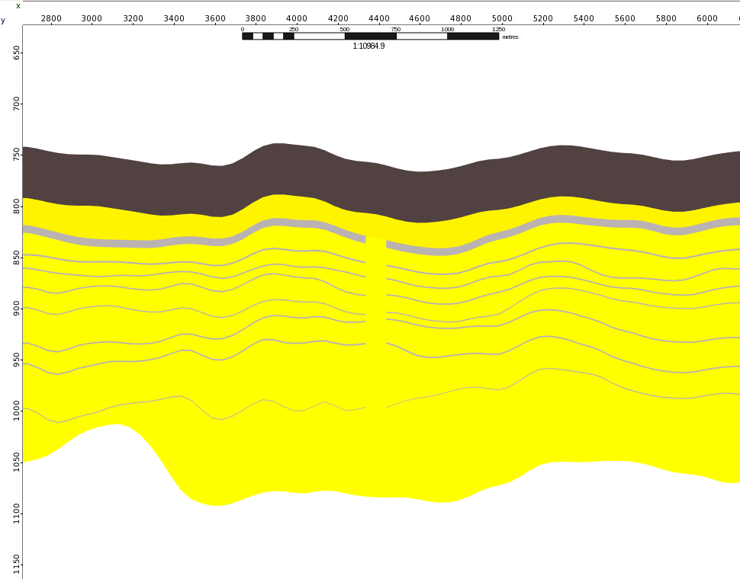
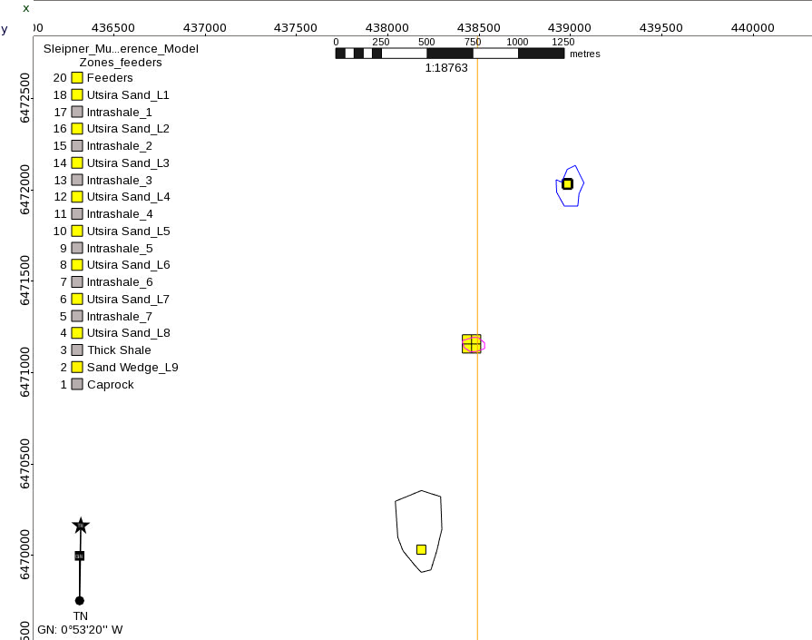
Main Feeder - Chimney
Seismic interpreted polygon with high confidence – 2 x 2 cells wide in the grid (100mx 100m) from L1 to L8

Slide 4

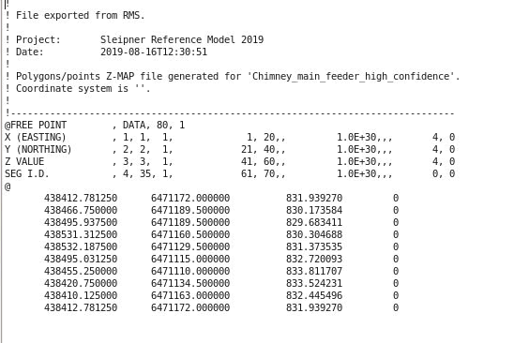
Polygons exported format
3 polygons exported on Zmap plus text format as example below:

